Slide 1
Thinking In Selenium Writing better pom
Fazali Illahi

Slide 2
Considerations before automation
WHAT IS UI TESTING
The process of testing a product's graphical user interface (GUI) to ensure it meets its specifications. (Wikipedia)
SELENIUM
Selenium automates browsers. That's it!
What you do with that power is entirely up to you.
SOMETHING MORE IMPORTANT
“If you automate a mess, you get an automated mess.” (Rod Michael)
“Always code as if the guy who ends up maintaining your code will be a violent psychopath who knows where you live.” (Martin Golding)

Slide 3
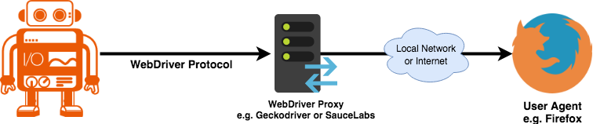
Web Driver protocol
WebDriver
WebDriver is a remote-control interface that enables introspection and control of user agents. It provides a platform- and language-neutral wire protocol as a way for out-of-process programs to remotely instruct the behavior of web browsers. (W3C)
SOURCE: https://webdriver.io/

Slide 4
Page objects
Goals
An abstraction layer over a UI component or a group of components or entire viewport exposing application specific API.
Examples
PlaceOrder, SignUp, AddToCart, AddToWishlist, ReviewProduct, Login are some of the examples in a standard shopping website.
Definition
Aimed to hide the low-level Selenium API and just exposes the application specific behaviors and helps reusing code.

Slide 5
Breaking into Page Objects

Slide 6
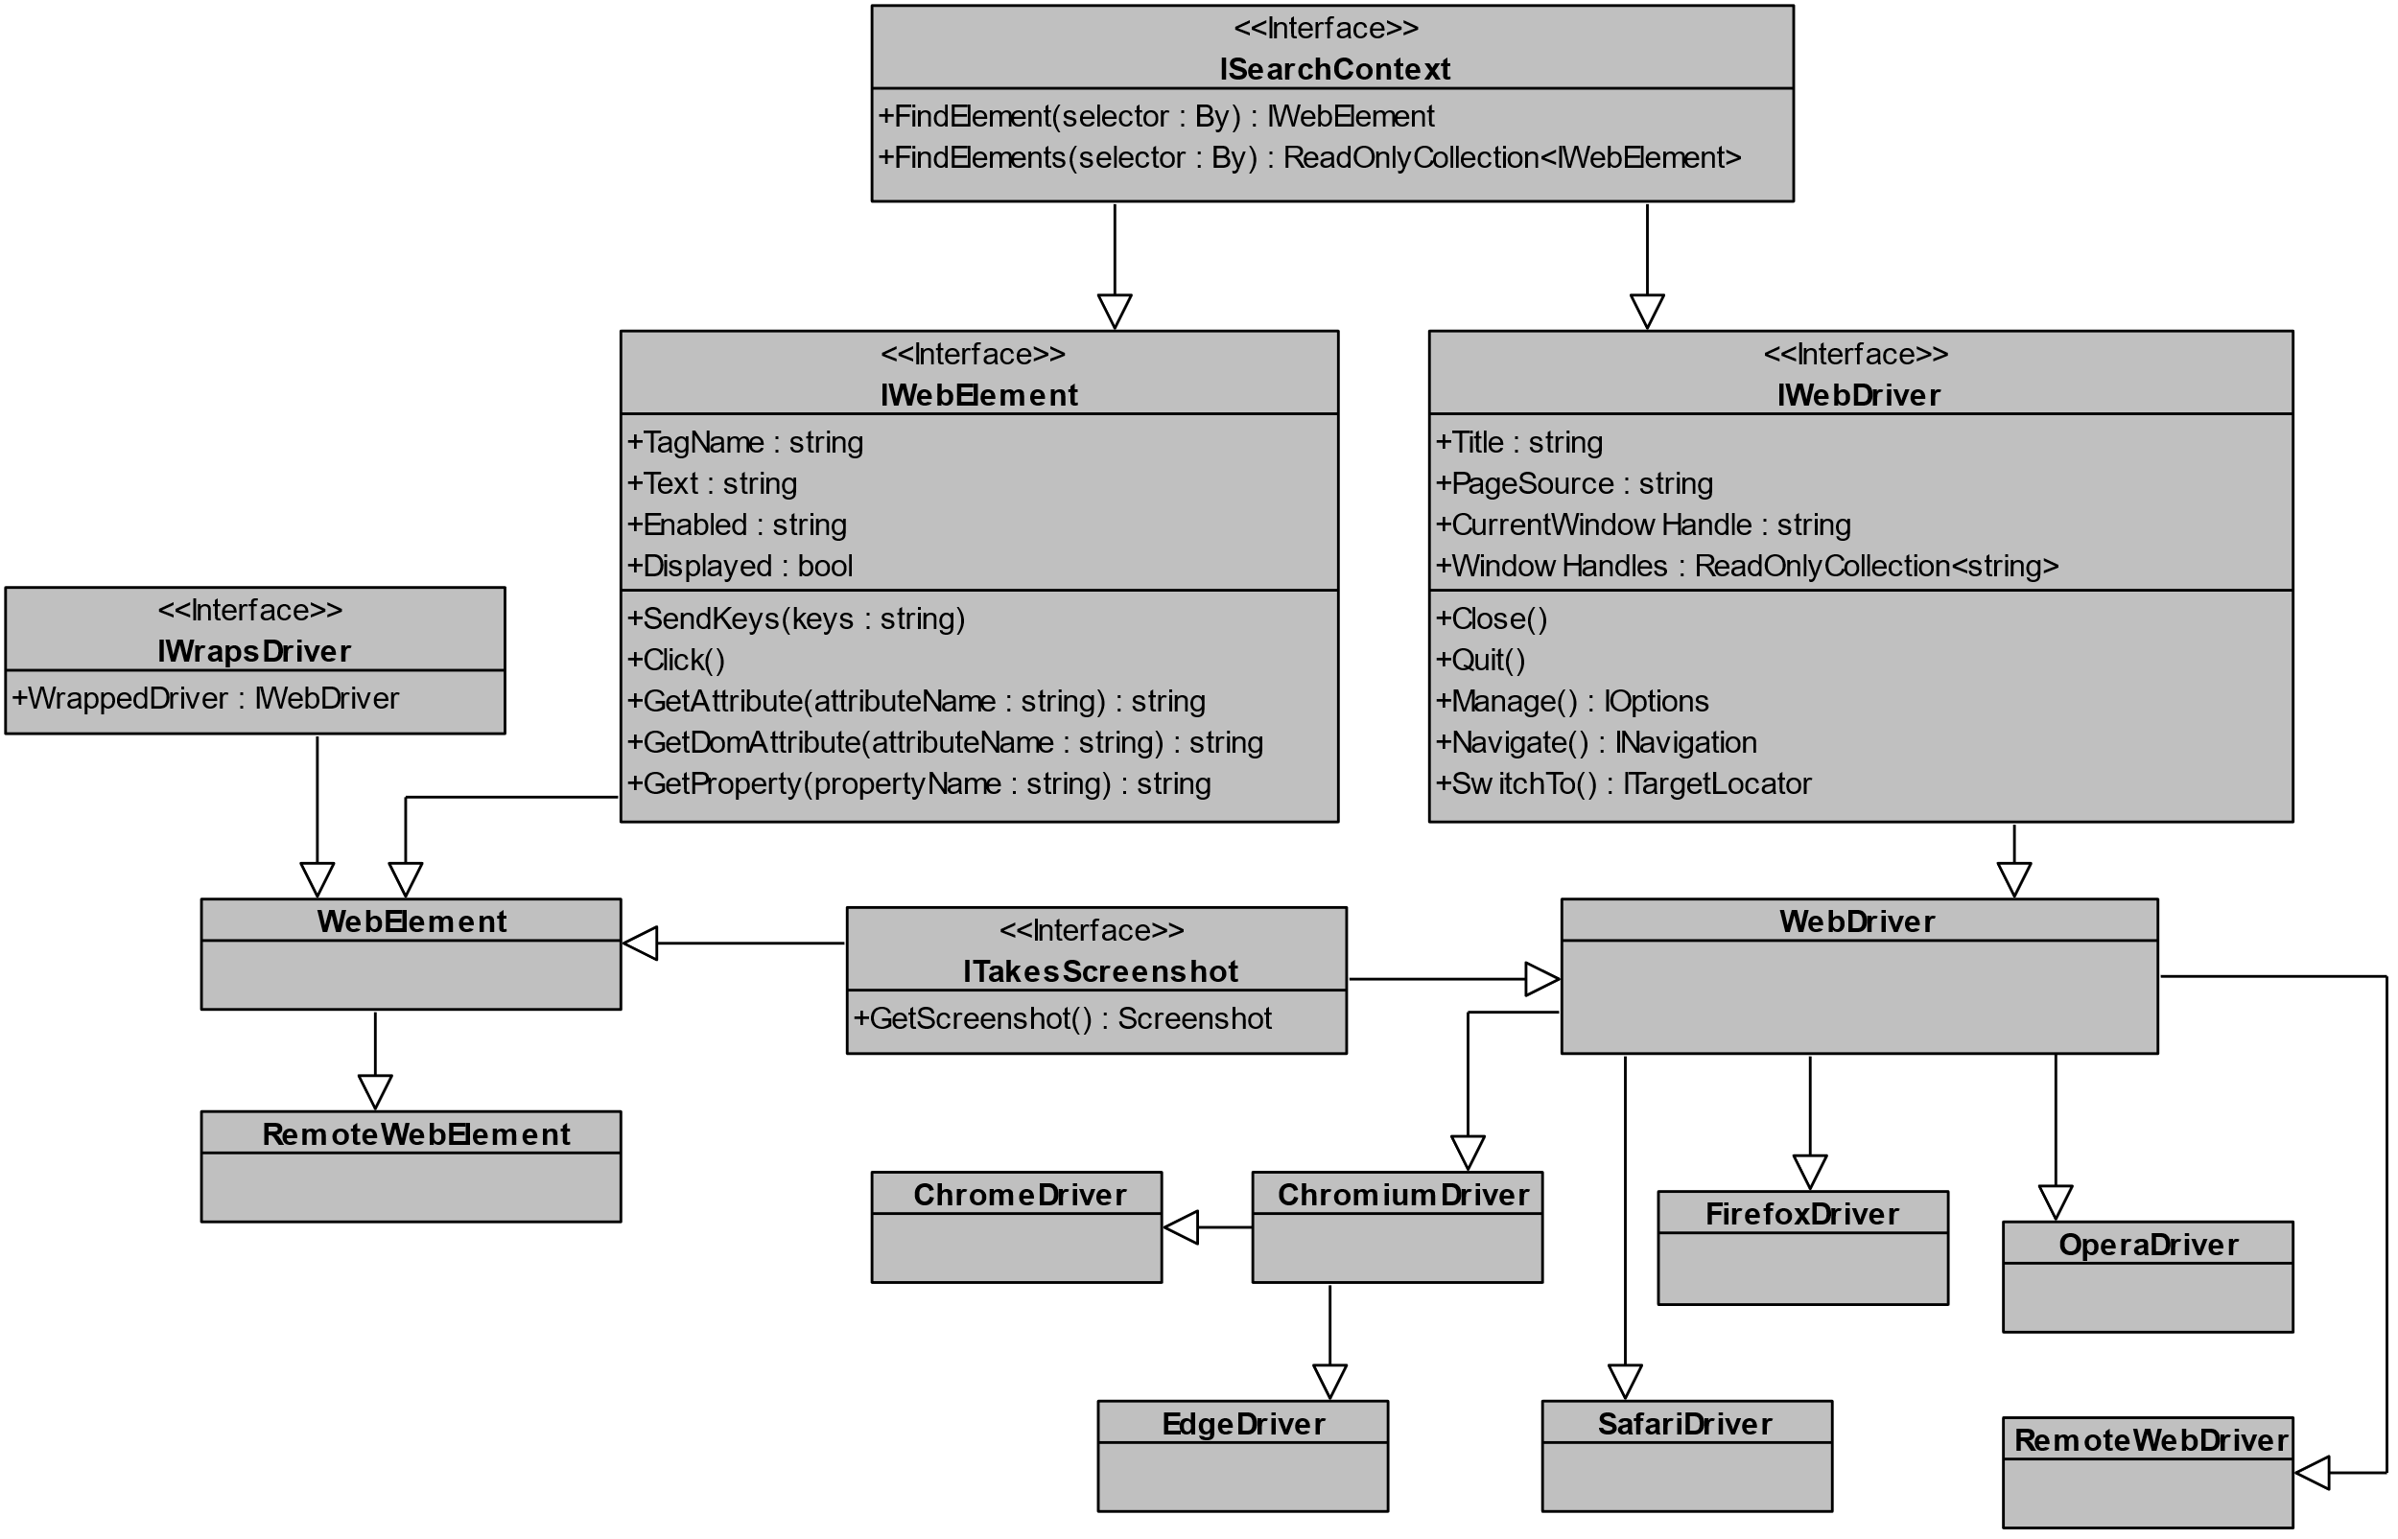
Class Diagram

Slide 7
Code reuse
Composition
Utility Classes
Function Overloading
Inheritance

Slide 8
SUMMARY
Our roles as a Tester
What UI Testing Selenium is?
WebDriver Protocol
Hierarchy of Selenium WebDriver and WebElement
Page Objects
Code Reuse Techniques

Slide 9
THANK YOU
Fazali Illahi​
7006283366
fazali.illahi01@gmail.com
https://in.linkedin.com/in/fazali-illahi
https://medium.com/@fazali-illahi

